Slide 1
Condenser Tool MVP-2
User Interface Design
(last revised June 10)

Slide 2
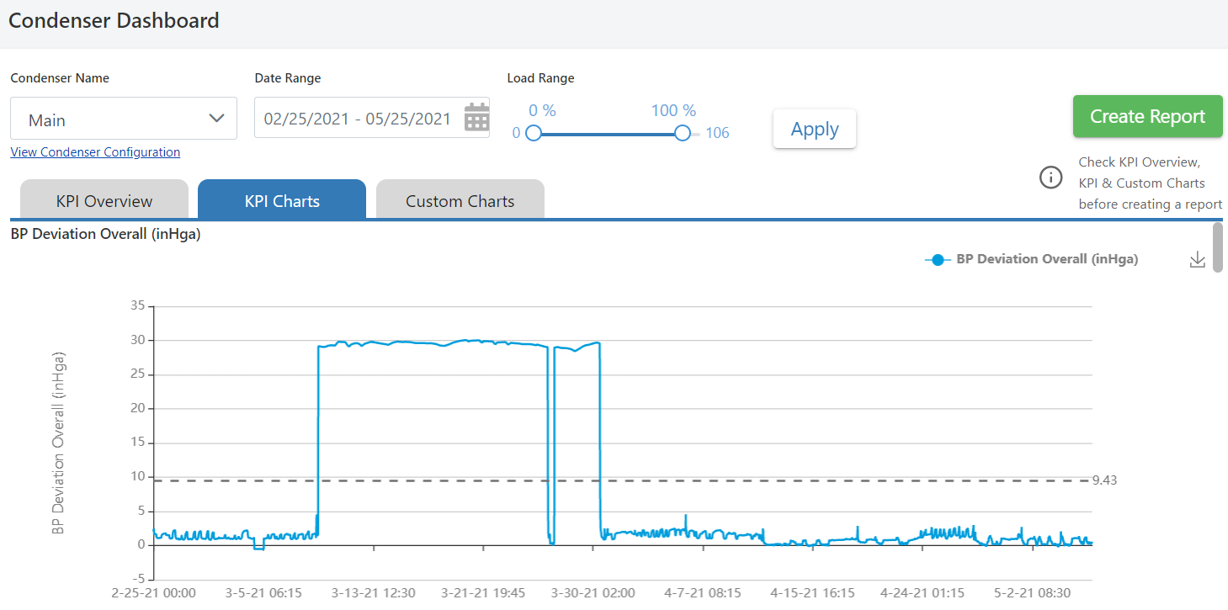
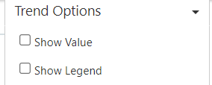

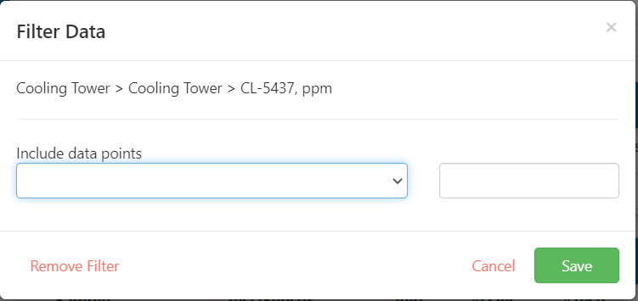
Publish cleaner data in reports / Filter ‘outliers’ from KPI and Custom charts and publish charts without outliers in report
Set Limits
Notes:
Fully Aligned

Slide 3

Publish cleaner data in reports / Create upper control limits with ability to set limits
Set Limits
Limits
Lower Limit:
Upper Limit:
Lower Limit:
The limits should be persisted and the same for all users of that chart for that condenser.
If the chart exceeds to upper limit or goes below the lower limit, the line of the chart should turn a red color. (note that no email notification needs to be sent)
Upper Limit:
Notes:
KPI and Custom Charts
-Changed to Set Limits remove Enable Alerts
Fully Aligned

Slide 4
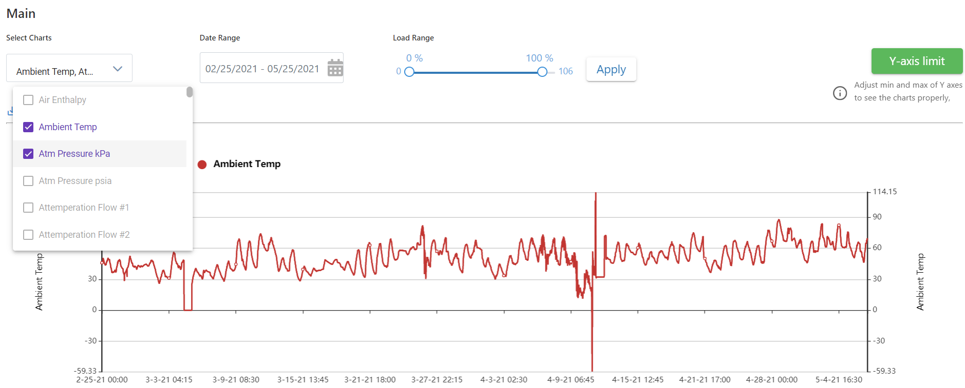
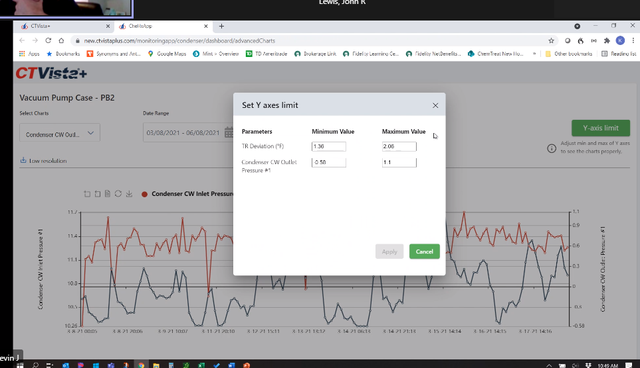
Identify anomalous trends / Advanced Charts
Advanced Chart page:
Allow multiple items to be checked aligning to Y1 or Y2 axis
Left Axis
Right Axis
Notes:
Create busier chart
Add 4 checkbox instead of two
Aligns with Vista’s 4 – so can use
Two Axis’ needed with multiple variables
Checkbox which axis a parameter is on

Slide 5
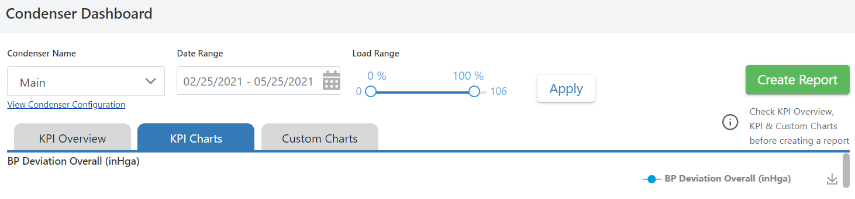
Identify anomalous trends / Scatter Charts
KPI Charts
Scatter Charts
Add a Scatter Charts tab
User should be able to create a scatter plot by selecting any two parameters available for trending. User should be able to specify which parameter goes on the x axis and which goes on the y axis.
Scatter plot can be refined using load range and date range filters.
Rsquared values should be generated and displayed in the graph area.
Desired snapshot/state of the analysis can be captured for adding in a report
Notes:
Select which is on x and y axis
Two Parameters

Slide 6
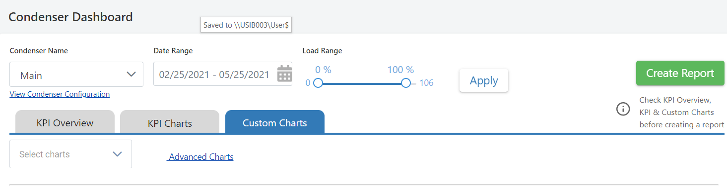
Identify anomalous trends / Custom Charts – Favorited Charts
Favorited Charts
User will have the ability to select multiple Custom Charts, and then save the grouping as a list of favorited charts. This list of favorited charts should be persisted and available to all users so that in future sessions that have the ability to click the Favorited charts link and the charts that have been favorited will be shown
Notes:
Favorite charts - Save Favorite charts with naming ability template
Create report with the charts prepopulated?

Slide 7
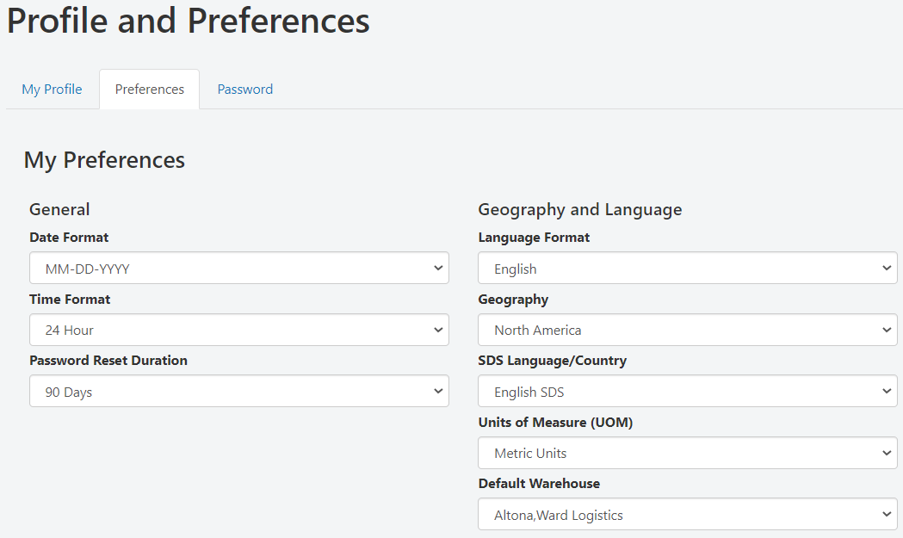
Language and metric
Leverage the existing language and Units of Measure preference specified in the user’s Profile and Preferences

Slide 8
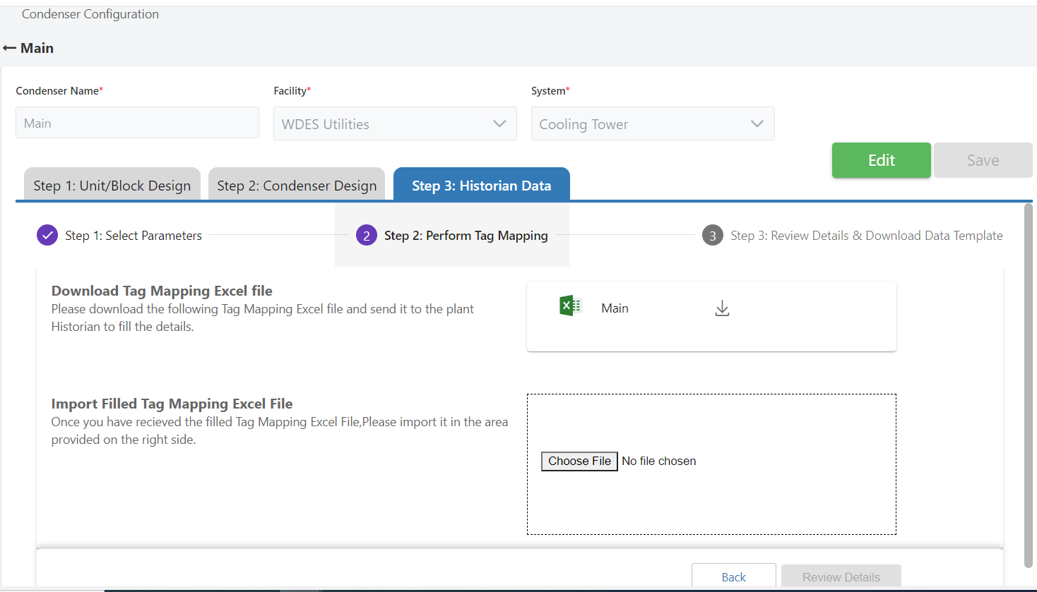
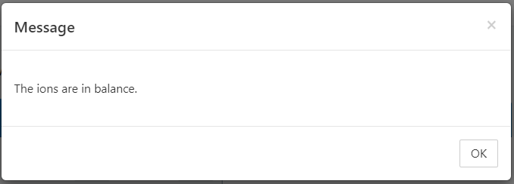
Data Uploads
The upload was successful !
Send email alert to user for data upload success or failure
As part of the upload process, have the tool remove non-empty cells to try to prevent the upload from failing
Notes:
Message popup
Upload directly to CTVista

Slide 9
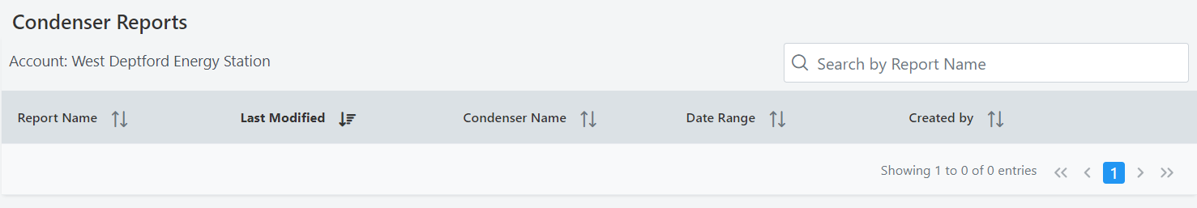
Data Uploads / Log
Upload Log
For Failures, show the error message
For Successes, show the number of records processed
Upload Log
Date of Upload | User | Success or Failure | Upload Details
Notes:
Popup for
@ details of success - # of records processed vs total
Historical LOG of them

Slide 10
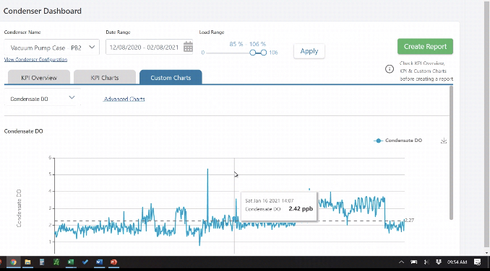
Charts – Adjust Y Axis
Y Axis Settings
Left Y Axis
Lower Limit:
Upper Limit:
Right Y Axis
Lower Limit:
Upper Limit:
Notes:
Control Y Axis to remove outlier data points

Slide 11
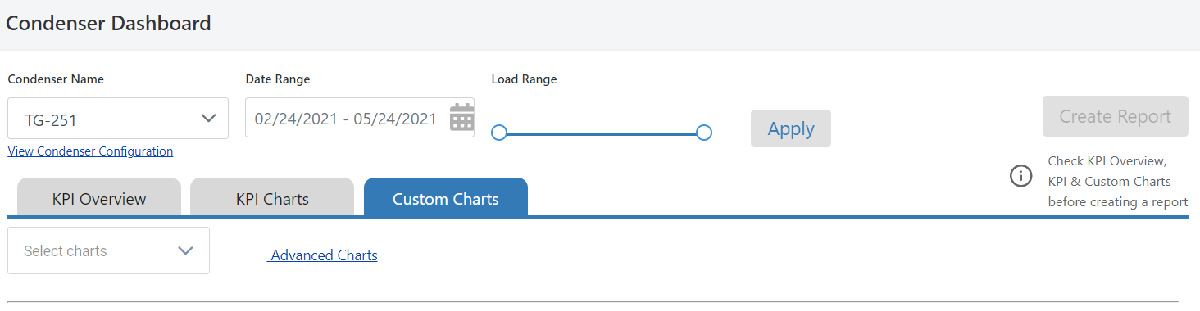
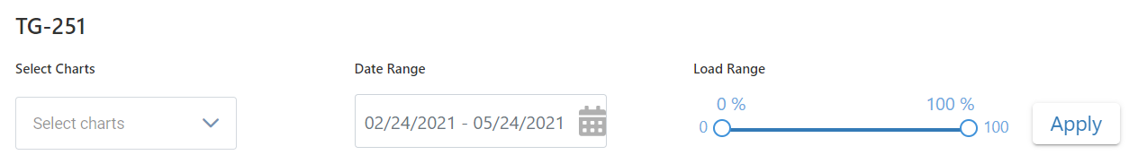
Adjusting the Date Range or Load Range
User should be able to change the Date Range or Load Range and not lose the entire report

Slide 12
Count of Data based on Load Range
Display the number of data points based on the load range
XXXXX Data Points

Slide 13
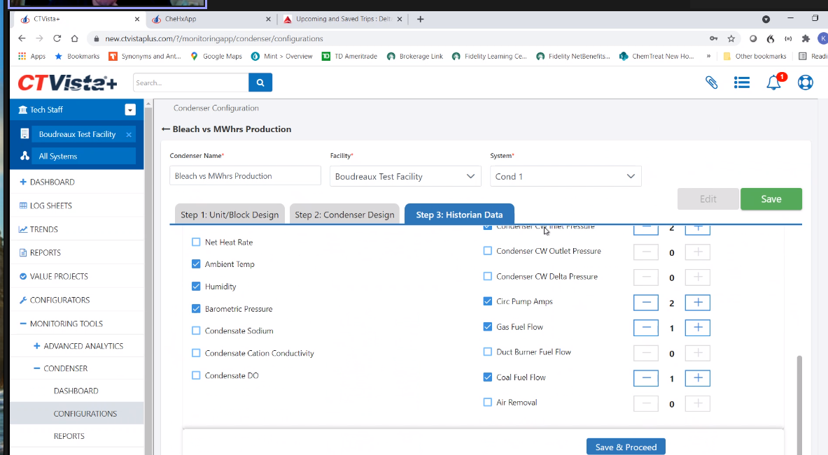
Adding custom parameters
Checkbox, Header text box and count added to Historian Data setup
(note that the custom parameters added here will not be needed in any calculations)
Notes:
Click button to Add Parameter showing blank name label, check box and select number you have
Goal is to reflect in parameters at end

Slide 14
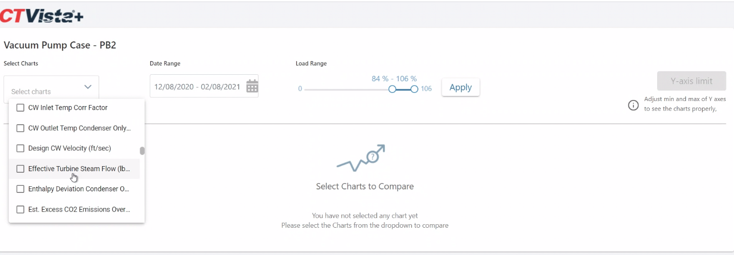
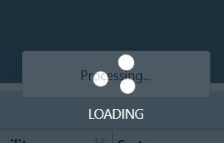
Status Bar for Chart Loading
Display a status indicator for chart loading
Notes:
Status bar to show progress of loading chart

Slide 15
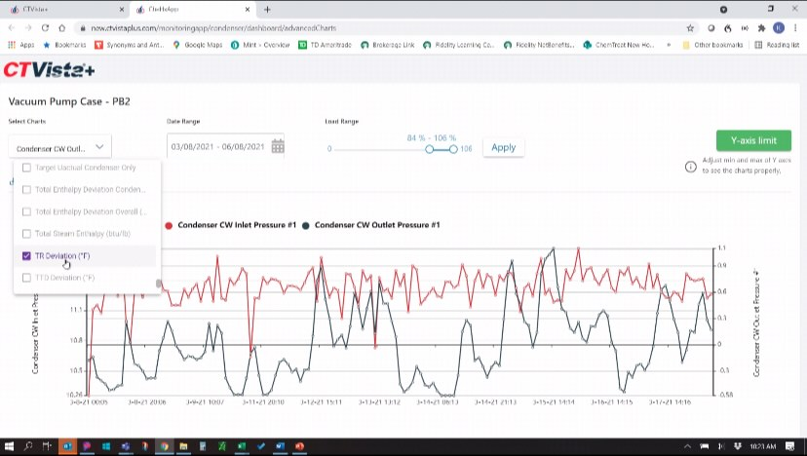
Intermittent Bug: Advanced Charts – The boxes checked aren’t always in sync with the charts shown (may be a refresh issue)
Selected variable not showing up in chart consistently

Slide 16
Identify anomalous trends / Plot averaged, summed values of parameters
Refer to:
Excel File: Condenser Efficiency Model (MASTER _ USE THIS)
Tab: Workbook Model
Condenser Operating BP #1 thru #4 – column AA → Need ability to ‘average’ and chart
Turbine Steam Exhaust Temp (Exhaust Steam Temp #1, #2, etc) – column AB → Need ability to ‘average’ and chart
Hotwell Temp – column – AC → Need ability to ‘average’ and chart
Total Boiler Steam Flow – column AD → Need ability to ‘sum’ and chart
Notes:
Graph floating variables that are not direct uploaded information
?
St Dev for anomalous trends?
Moves to DHRD
How does this happen

